Slide 1
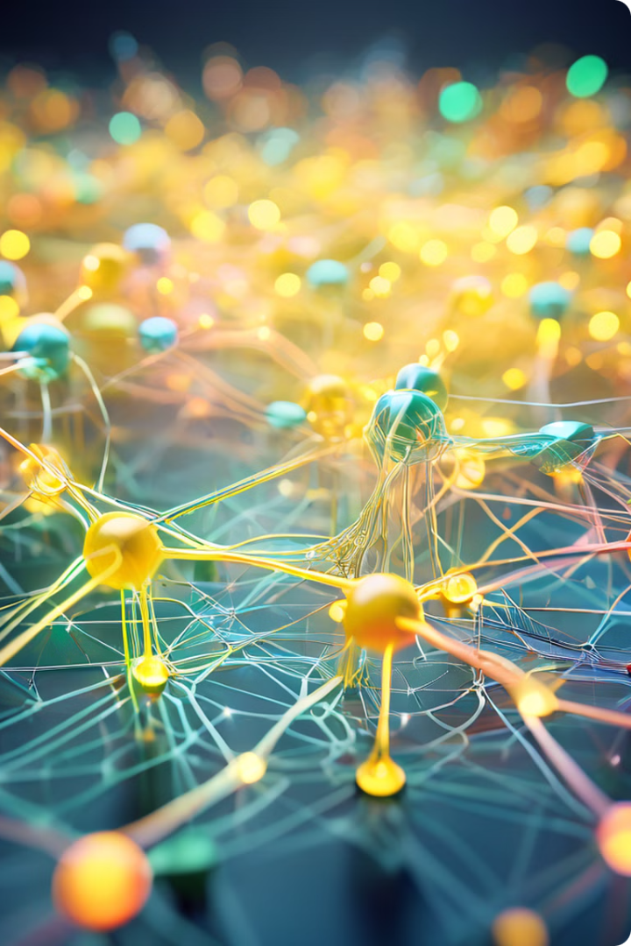


Introduction to Neural Networks
Welcome to the world of neural networks, where computers learn to mimic the human brain. This presentation will explore the fundamentals of neural networks, from their basic components to their real-world applications.
by Juvenile teachers

Slide 2
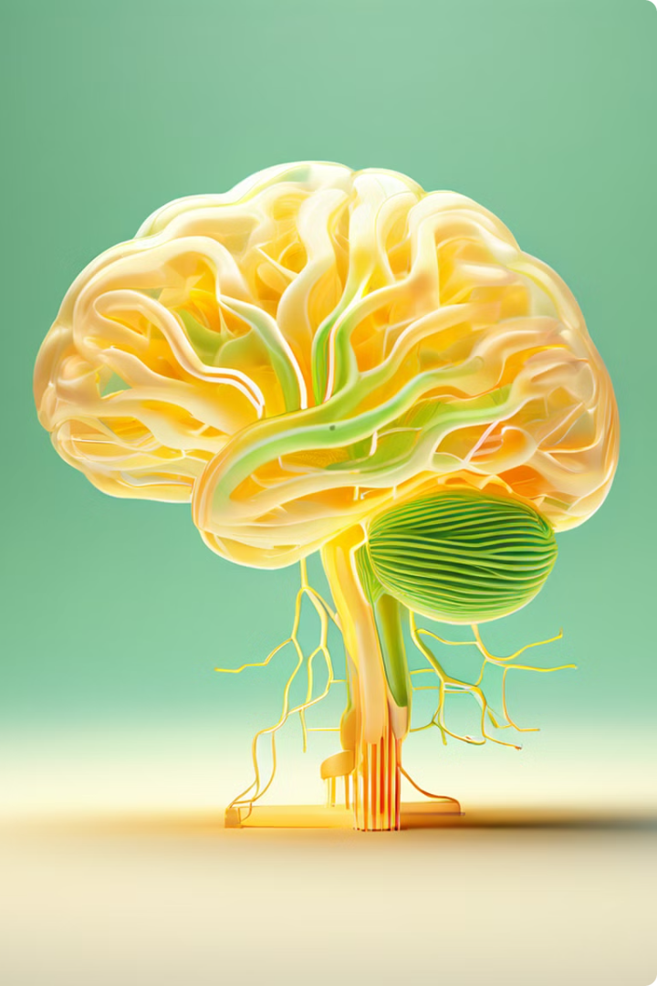
What are Neural Networks?
Neural networks are powerful computing systems inspired by the structure of the human brain. They consist of interconnected nodes called neurons, organized in layers. These networks learn by adjusting the strength of connections between neurons based on input data.
Inspired by Biology
Neural networks are modeled after the intricate network of neurons in the human brain, which process information and make decisions.
Learning from Data
They learn from data by adjusting the strength of connections between neurons, enabling them to recognize patterns and make predictions.
Versatile Applications
Neural networks have a wide range of applications, including image recognition, natural language processing, and self-driving cars.

Slide 3
Key Components of Neural Networks
Neural networks consist of fundamental components that work together to process information. Each component plays a crucial role in the network's ability to learn and make predictions.
Neurons
Layers
Connections
The building blocks of a neural network, each neuron receives input, performs calculations, and outputs a value.
Neurons are organized into layers, with information flowing from the input layer to the output layer through hidden layers.
Connections between neurons, called synapses, represent the strength of the relationship between them, allowing information to flow.

Slide 4
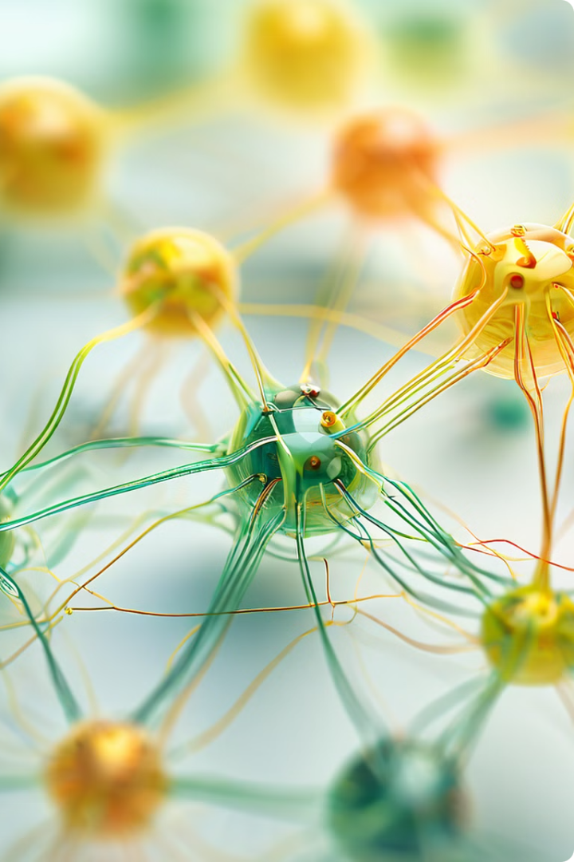
Understanding Parameters in Neural Networks
Parameters are the adjustable values within a neural network that determine its behavior and learning capabilities. These parameters are learned during training and influence the network's predictions.
1
Weights
Weights represent the strength of the connections between neurons, determining how much influence each neuron has on its neighbors.
2
Biases
Biases are constants added to the neuron's output, adjusting the activation threshold and influencing the network's decision-making process.

Slide 5
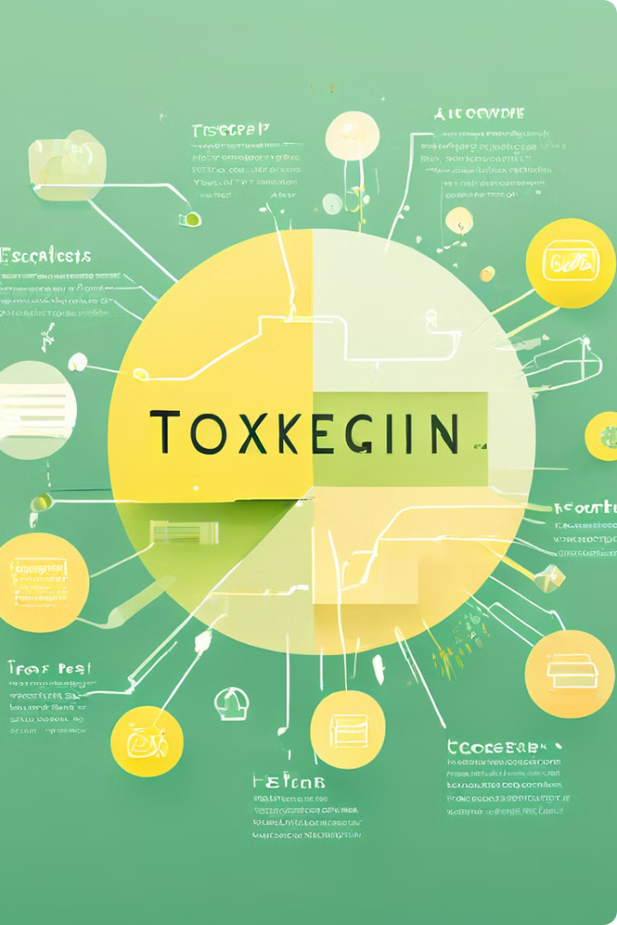
Understanding Tokens in Neural Networks
Tokens are the smallest units of information processed by neural networks in tasks involving text data. Tokenization is the process of breaking down text into individual tokens, enabling the network to understand the meaning of the text.
Tokens
Definition
Example
Words
Individual words in a sentence.
The quick brown fox.
Subwords
Parts of words or morphemes.
quick, brown, fox
Characters
Individual letters in a word.
t, h, e, q, u, i, c, k, b, r, o, w, n, f, o, x

Slide 6
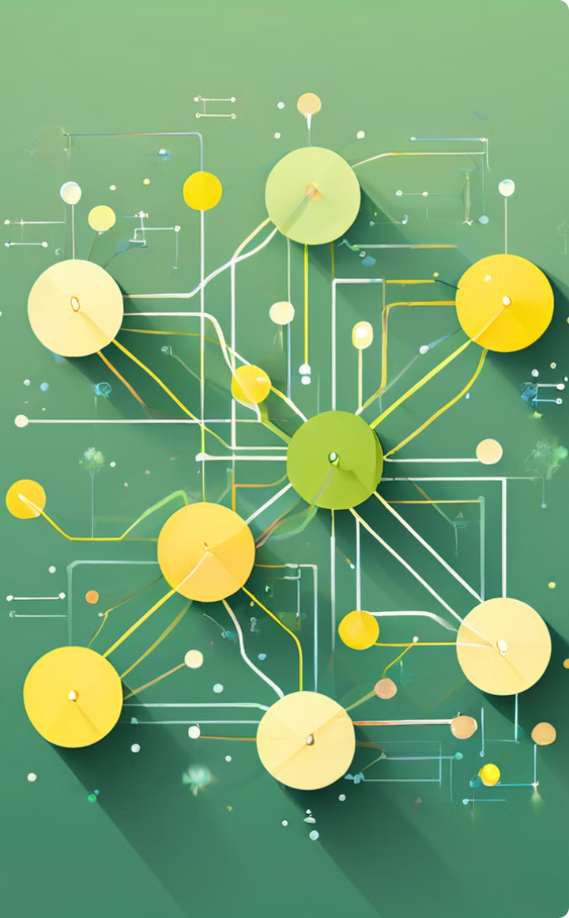




Training and Optimizing Neural Networks
Training a neural network involves feeding it with data and adjusting its parameters to minimize errors in its predictions. Optimization techniques refine these parameters, improving the network's performance over time.
Data Preparation
Prepare and preprocess the data to ensure it's in the right format for training.
Training Process
Feed the network with data and adjust its parameters to improve its predictions.
Evaluation
Evaluate the network's performance on unseen data to assess its generalization ability.
Optimization
Refine the parameters using optimization algorithms to improve the network's performance.

Slide 7





Applications of Neural Networks
Neural networks have revolutionized various fields, enabling computers to perform tasks that were once considered exclusive to human intelligence. Their applications span diverse domains, from image recognition and language translation to self-driving cars and medical diagnostics.
Image Recognition
Neural networks can identify objects, faces, and scenes in images, enabling applications such as facial recognition and medical image analysis.
Natural Language Processing
Neural networks can understand and generate human language, enabling applications such as machine translation, text summarization, and chatbots.
Self-Driving Cars
Neural networks are used in self-driving cars to perceive the environment, make decisions, and control the vehicle.
Medical Diagnosis
Neural networks can analyze medical images, diagnose diseases, and predict patient outcomes, assisting doctors in providing better care.

Slide 8

Conclusion and Key Takeaways
Neural networks are transformative technologies with the potential to revolutionize numerous industries. Understanding their fundamental components, training methods, and applications is crucial for navigating the rapidly evolving world of artificial intelligence.
1
Power of Computation
Neural networks harness the power of computation to mimic the human brain's ability to learn and make decisions.
2
Versatile Applications
These networks have applications across diverse domains, enabling solutions to complex problems.
3
Future of AI
Neural networks are at the forefront of artificial intelligence, shaping the future of technology and society.

